Slide 1
Power BI Dashboard: Sales & Profit Analysis

Slide 2
Objective & Overview
Content:
Objective of the Assignment:
“The goal of this assignment is to analyze the sales and profit data from the Superstore dataset using Power BI to create visualizations that provide actionable insights for decision-making.”
Key Deliverables:
Data Cleaning & Transformation
Key Visualizations
Dashboard Design
Insights & Recommendations
Dataset Used:
"Superstore Sales Dataset" (or whichever dataset you used).

Slide 3
Dataset Overview
Content:
Dataset Used: Superstore Sales Dataset
Data Types:
Order Details: Order ID, Order Date, Ship Date
Customer Details: Customer Name, Customer Segment
Product Details: Category, Sub-Category, Product Name
Sales Data: Sales Amount, Profit, Discount, Quantity
Geography: Region, State
Data Cleaning Process:
Handle missing values
Remove duplicates
Correct data type

Slide 4
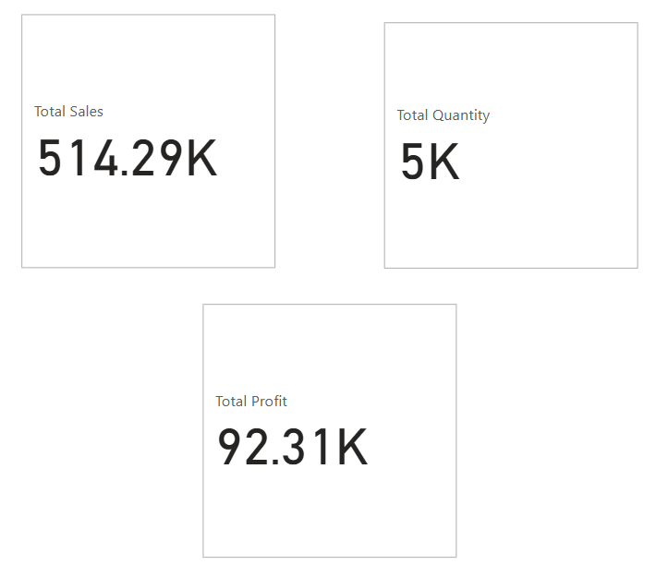
Key Performance Indicators (KPIs)
Content:
Total Sales
Total Profit
Total Quantity Sold
Visuals:
Include a screenshot of your KPI Cards from Power BI, each representing Total Sales, Total Profit, and Total Quantity Sold.
Key Insights:
Total Sales: Shows the overall revenue generated within the selected period.
Total Profit: Represents the profitability, highlighting the efficiency of sales relative to costs.
Total Quantity Sold: Reflects the volume of products sold, which can be used to assess demand or product popularity.

Slide 5
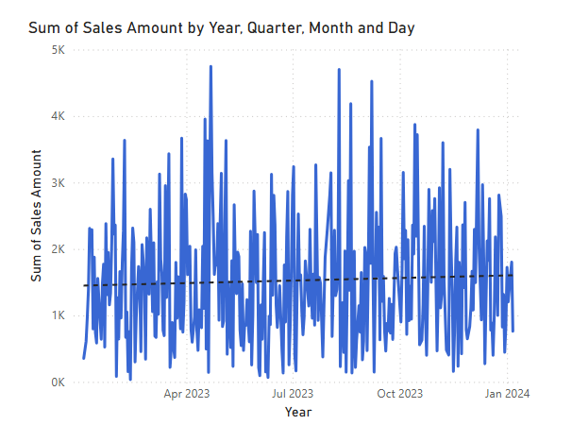
Monthly Sales Trends
Content:
Line Chart showing the monthly sales trends.
Insights:
“Sales show a peak in [Month], with a slight drop in [Month]. This can be attributed to [reason or event].”

Slide 6
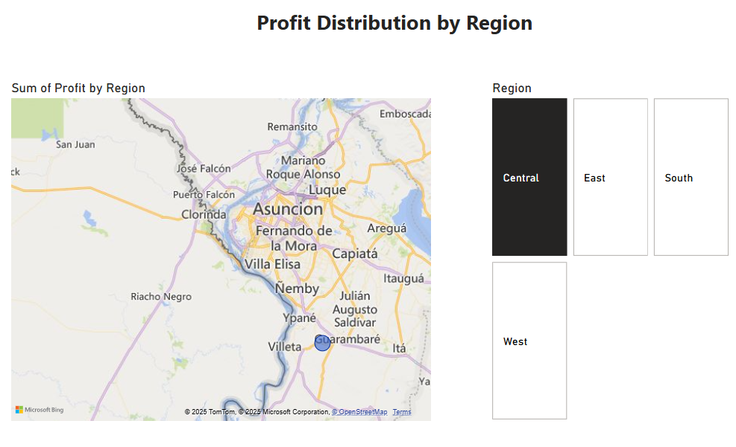
Profit Distribution Across Regions
Content:
Map Visual showing profit distribution by region.
Insights:
"The highest profit is observed in [Region]."
"The lowest profit is seen in [Region], which requires further analysis."

Slide 7
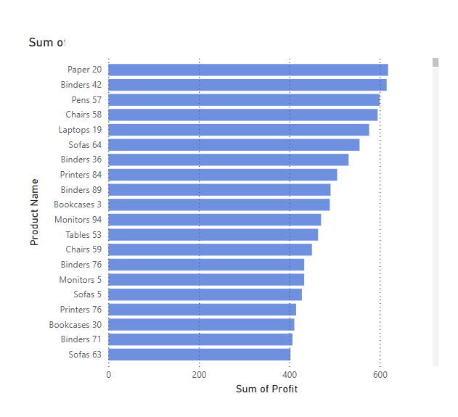
Top & Bottom Products by Profit
Content:
Bar Chart displaying the top and bottom products by profit.
Insights:
"Product A and Product B generate the highest profits."
"Product X is underperforming, and its sales should be analyzed further."

Slide 8
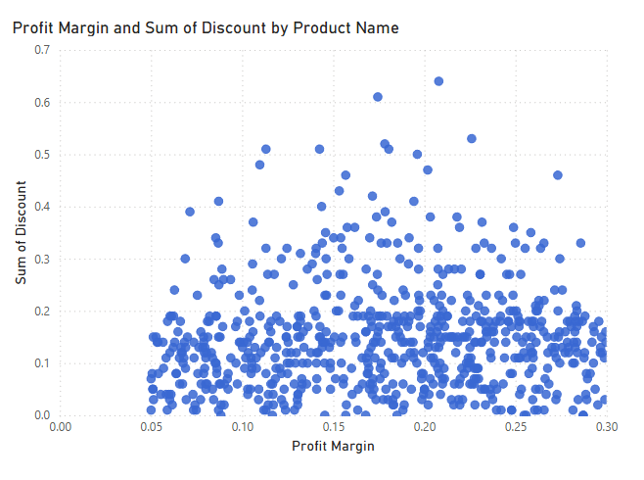
Impact of Discounts on Profit
Content:
Scatter Plot showing the relationship between discount percentage and profit.
Insights:
"A higher discount does not necessarily correlate with higher profit."
"The optimal discount range for maximum profit is between [X% and Y%]."

Slide 9
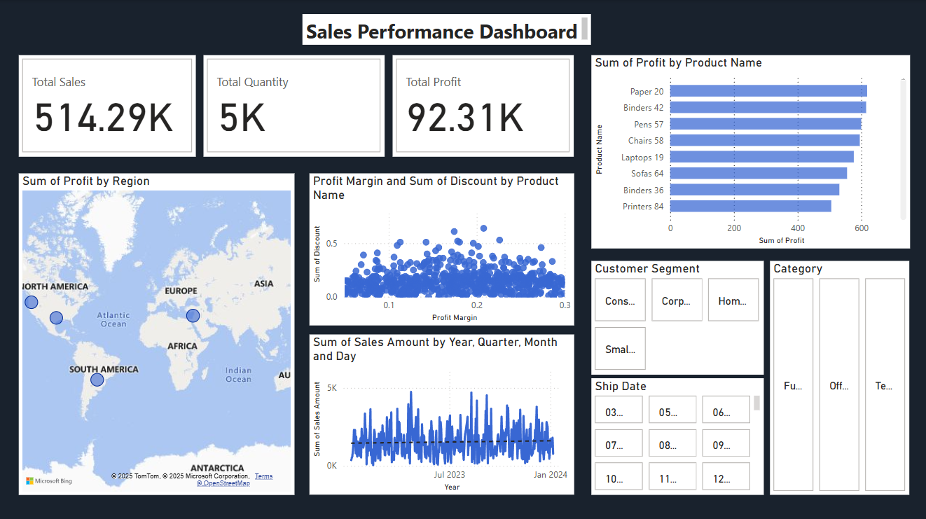
Sales Performance Dashboard
Objective:
"A comprehensive dashboard showcasing key sales, profit, and performance metrics."
Visual:
Insert a screenshot of your full Power BI dashboard.
Key Features:
Interactive Filters: Date Range, Region, Customer Segment, Product Category.
Drill-through: Access detailed views for deeper insights.
Insights:
"User-friendly interface for quick decision-making."
"Provides real-time, actionable business insights."

Slide 10
Key Insights & Recommendations
Content:
Insights:
"The sales in Region A are significantly higher than other regions."
"Certain product categories consistently outperform others, such as Electronics and Furniture."
Business Recommendations:
"Focus marketing efforts on Region A to capitalize on strong sales."
"Consider promoting low-performing products to improve their sales."
"Optimize pricing and discount strategies to improve profit margins."

Slide 11
Conclusion
Content:
"This dashboard provides actionable insights into sales, profit, and product performance."
"By leveraging interactive features, users can make data-driven decisions to improve business performance."
"Further analysis can be conducted to explore underperforming regions and products."

